Slide 1
Daria Juretic - Elissavet Kourakou – Buket Senoglu - Alice Vidal
Setting up an ESD center in the village of Leon (France)

Slide 2
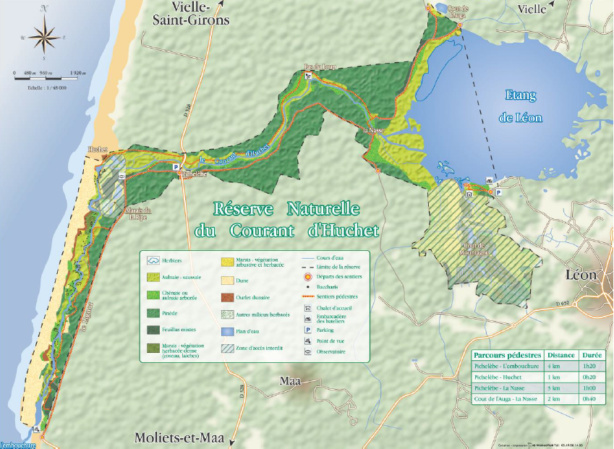
INTRODUCTION
➔ Establishment of a Centre for Education for Sustainable Development in France
➔ Location close to the protected area, rich in biodiversity and cultural heritage
➔ Natural reserve of the Courant d’Huchet and the village of Léon
➔ OBJECTIVES : Investigate the possibilities, evaluate the results and recommend actions, concerning the establishment and the function of the ESD center

Slide 3
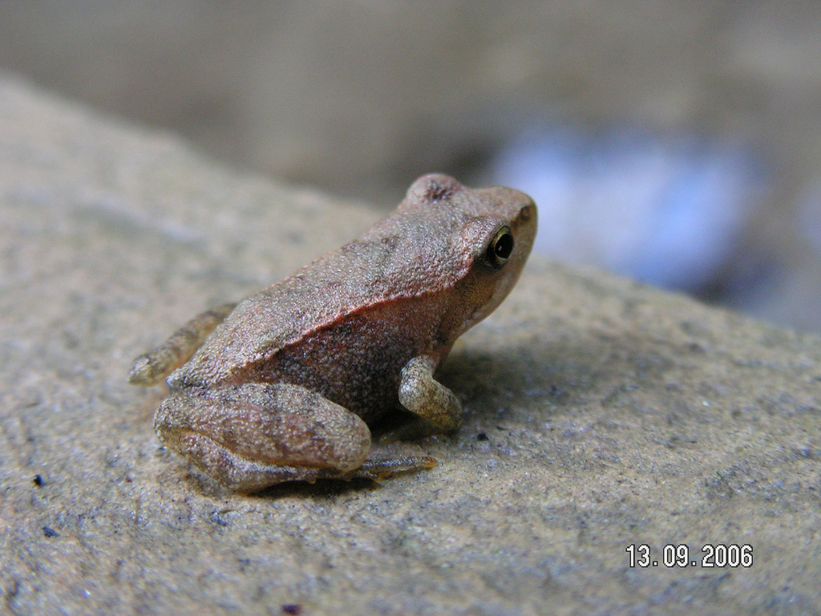
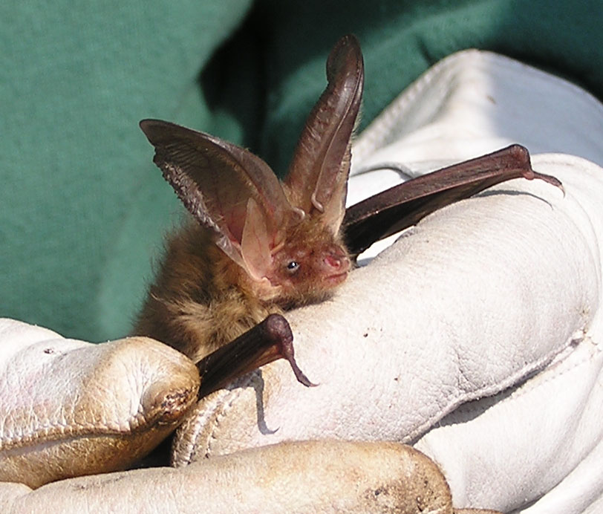
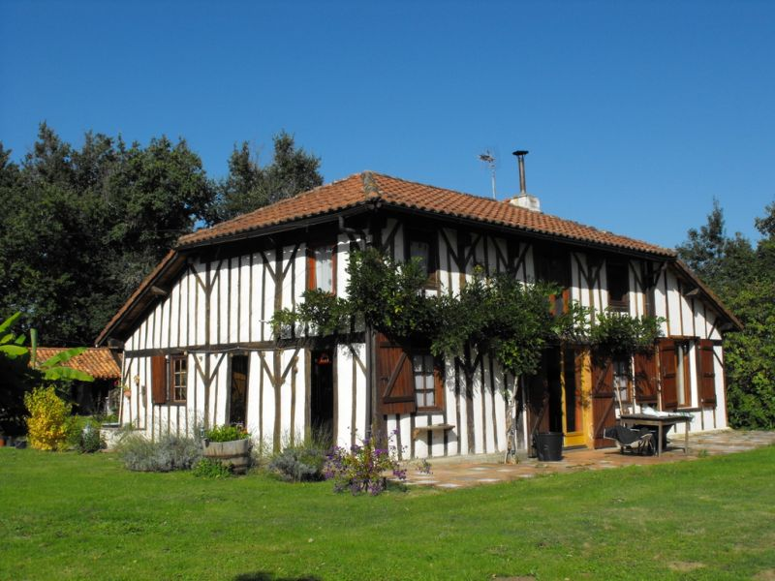
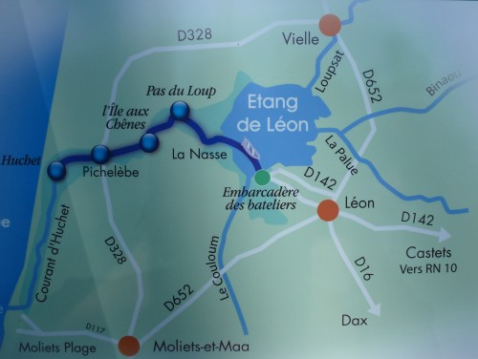
METHODOLOGY
Group development Model: Forming Storming Norming Performing.
Analysis Model: SWOT
Technique: Brainstorming
Tools: literature and webpage review, observation, interviews
RESULTS & RECOMMENDATIONS
Objectives Recommendations
Special characteristics National Nature reserve
Local problems Tourism, Industry, Agriculture,
Local natural and cultural wealth Awareness
Positive attitudes, actions Educational programs
Prerequisites Recommendations
The provision of a place Adjacent and accessible
Cooperation Scientists, stakeholders, local community
Partnership Institutions, authorities, local associations
Educators Ecological, Pedagogical, ESD

Slide 4
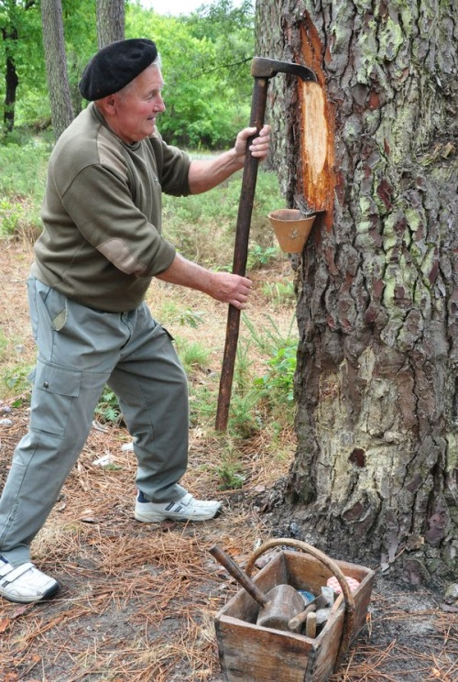
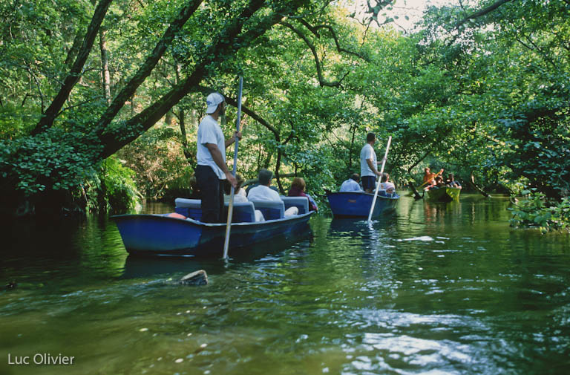
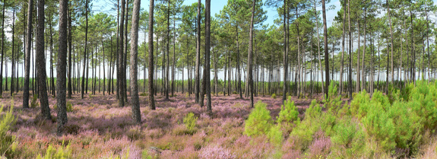
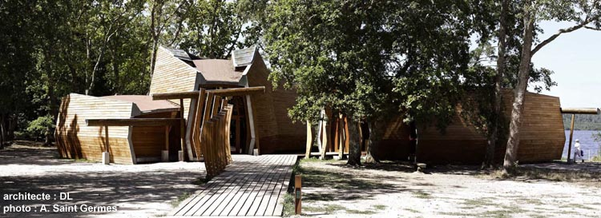
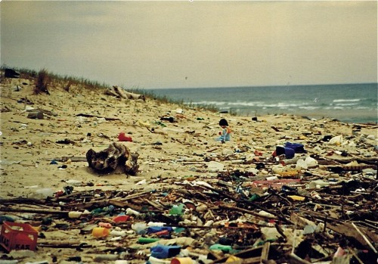
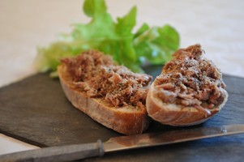
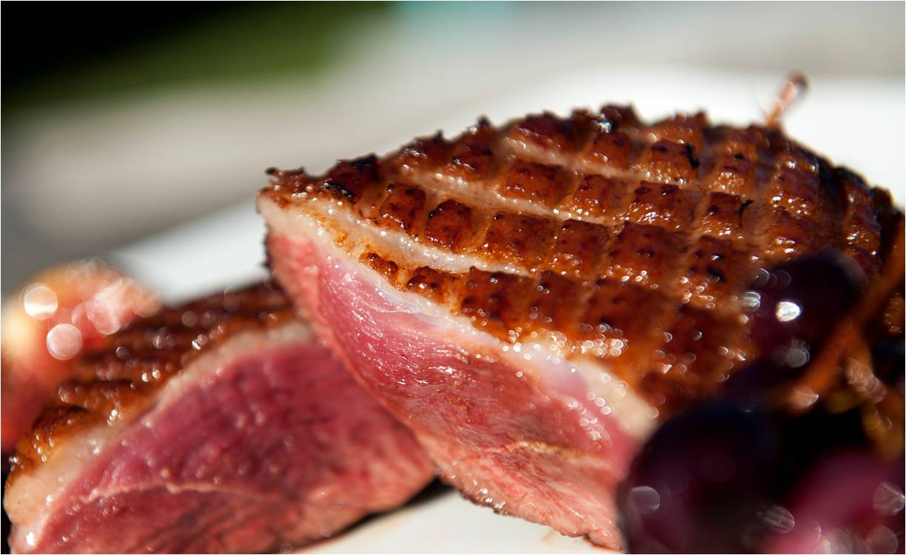
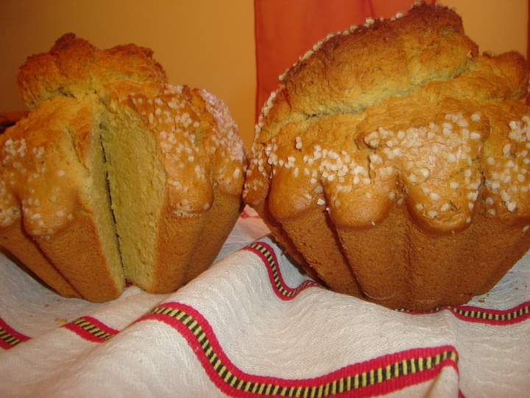
TOOLS & RECOMMENDATIONS
Time | Activities | Goal
09:00 | Brief introduction | To enhance kids’ ability of perception.
10:00 | To clean the sand and to collect different types of materials | To raise the awareness of diversity of waste and to look at the consequences of uncontrolled waste disposal.
11: 00 | Discussion + evaluation
12:00 | Lunch time (local products) | To initiate children to customs
13:30 | Introduction (movie, map, pictures)
15:00 | Walk into the forest & demonstration of the activity :“the gemmage” | To realize the importance of the richness of the environment, and the dependence of the man on the environment.
16:00 | Visit of the museum | To learn and speak about the greenhouse concept
16:30 | To embark in “barques” | To observe the nature from another perspective
18:00 | Make a class poster + evaluation
➔ Adaptation of this program to different level of learners
➔ Educational program for formal schools, NGOs, local business and community

Slide 5
OVERALL CONCLUSION
Necessity of an ESD center in the village of Leon
Sensibilisation of the community
Support of the ESD in formal and non-formal education by creating alternative education courses as well as materials
Enhancement of the relationship with the local community

Slide 6
THANK YOU FOR YOUR ATTENTION

